Slide 1
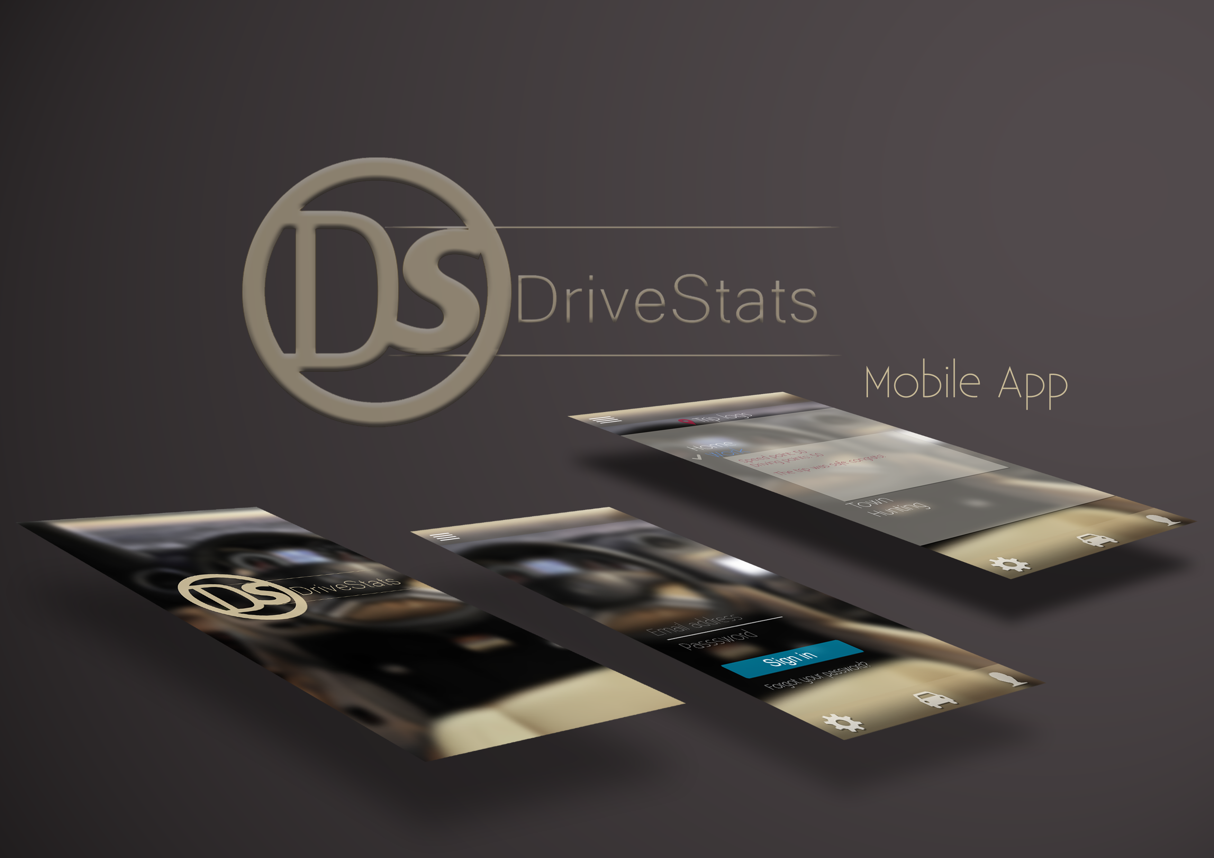
Second Presentation
24-07-2015

Slide 2
A Quick Recap
What We Are Doing
Enthusiastically creating and implementing an application using a C# server and Android Client.
The aim of this project is to produce an app that can record and monitor the driving activity of South African residents and improve driver safety across a range of indicators.
Our project was created to service the Client DVT

Slide 3
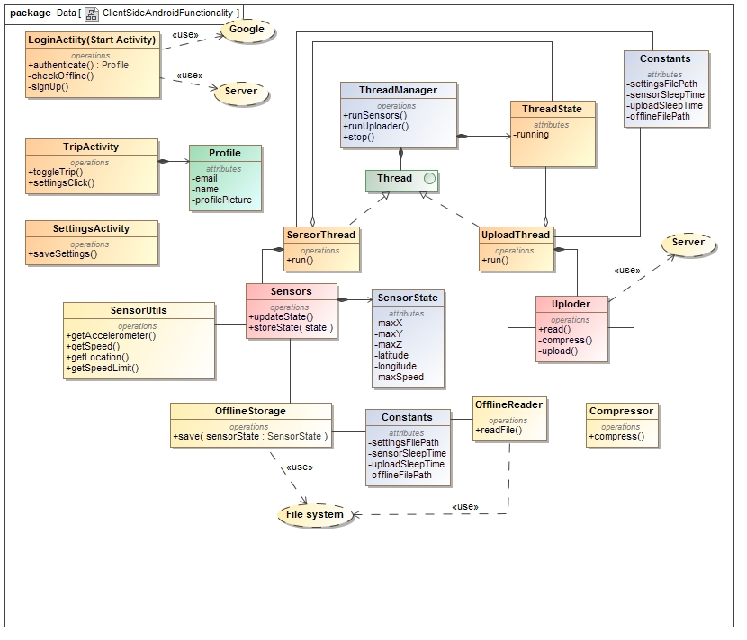
Client Side Class Diagram

Slide 4
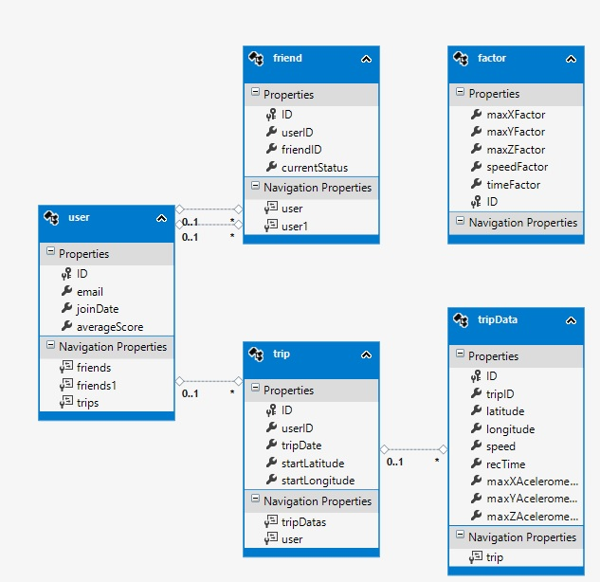
Database Structure

Slide 5
Our Current Capabilities
Android application
Run application in background
Upload and store application data on server
Add users
Database persistence
Mock algorithm data
Server hosting
Calibration

Slide 6
Achievements Since Last Presentation
Axel Ind: Research pertaining to algorithm development. Technical and documentational support.
Zander Boshoff: Server creation, database creation, database manager creation.
Nick Robinson: Created basic Android application, implemented data capturing, server communication, OR mapping.
Tim Kirker: HTML creation, server communication.
William Seloma: Android creation support (extensive contact and collaboration with Nick)

Slide 7
Challenges We Have Encountered
Google Login
Speed Limit Gathering
Data Compression
Server Hosting
Team Communication
Algorithm Development

Slide 8
Our Initial Concepts For UI

Slide 9
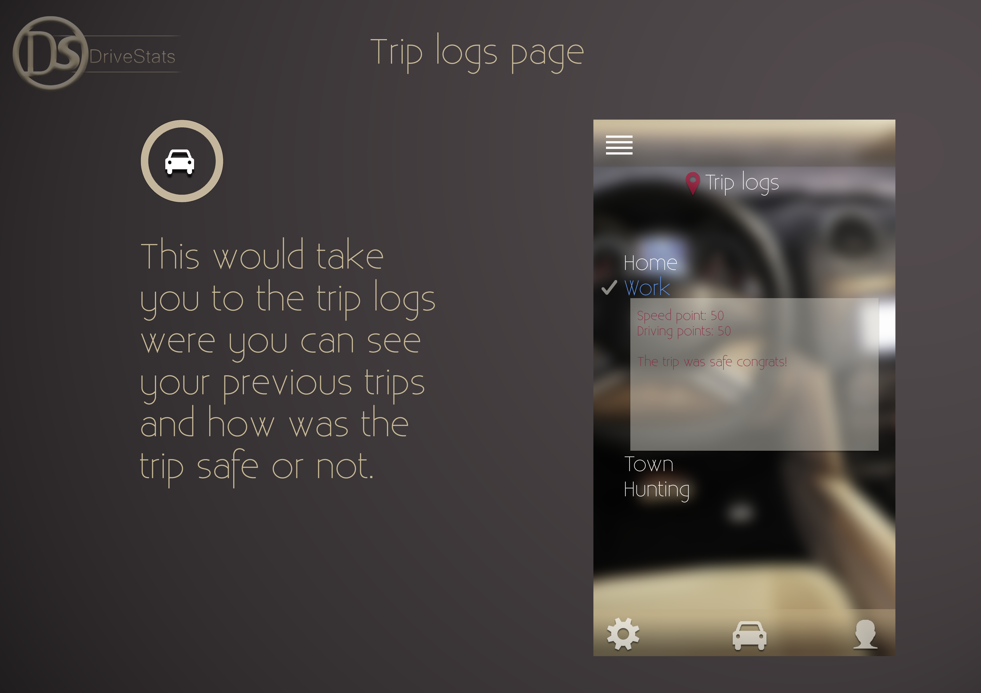

Slide 10
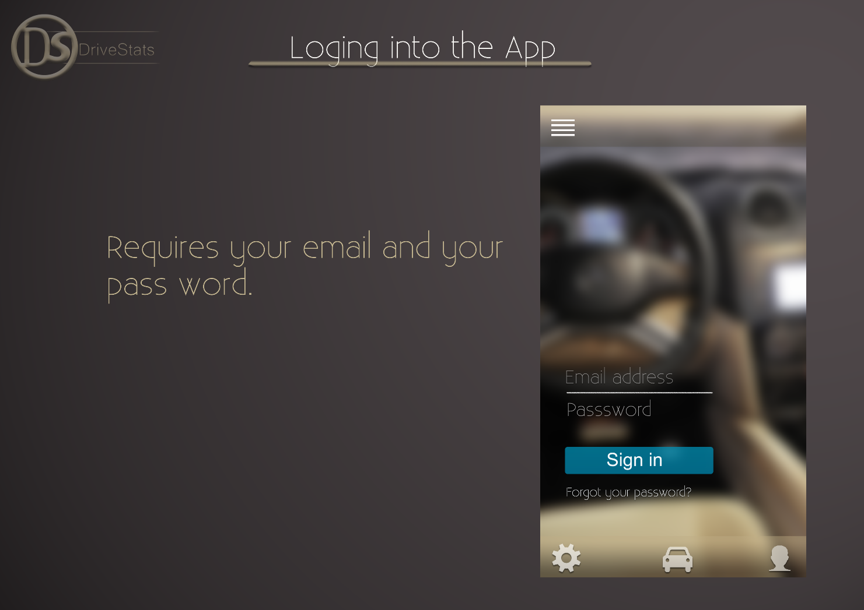

Slide 11
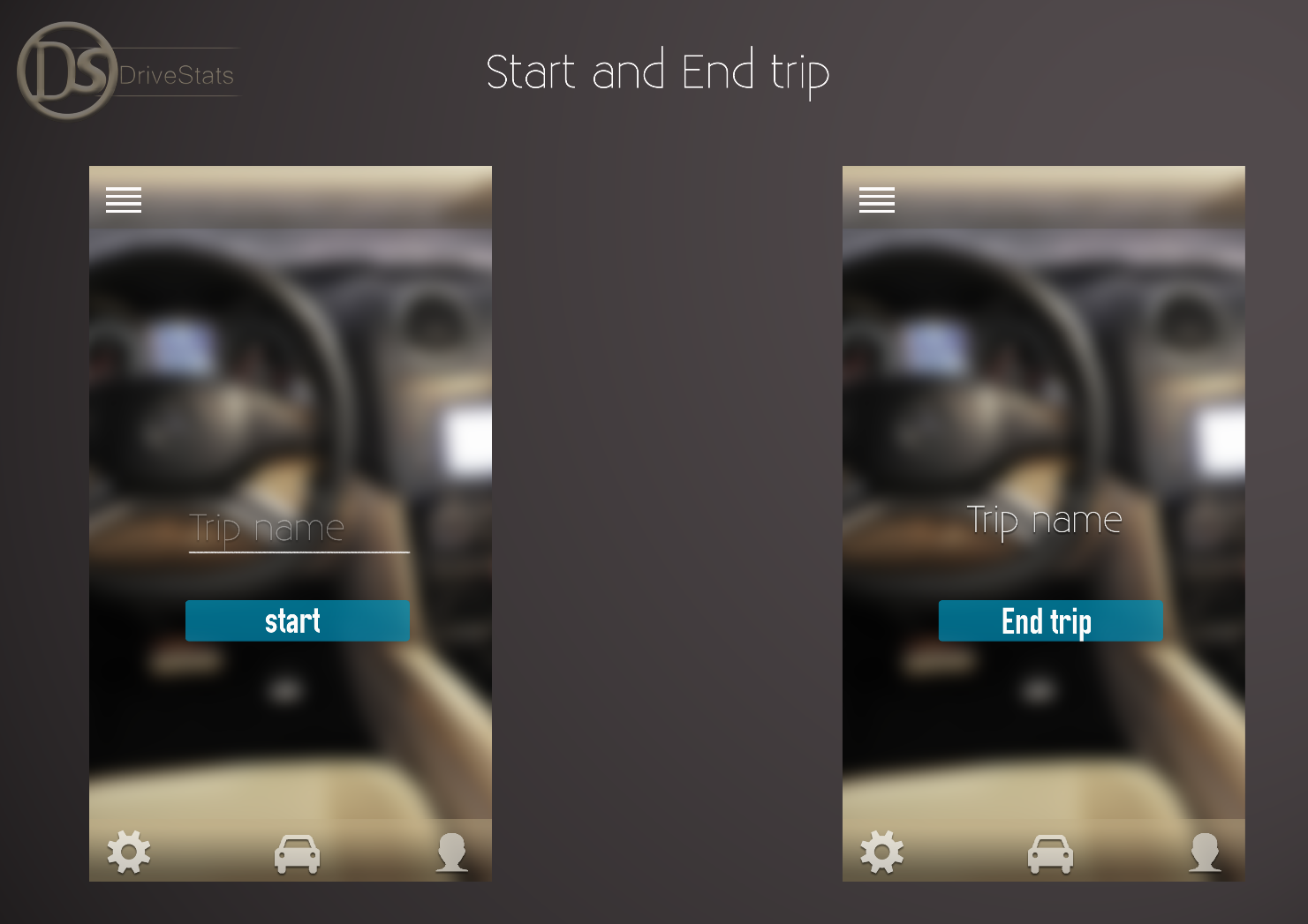

Slide 12
And many more ideas to come…

